Slide 1
Superstore Return Analysis
Analysis and Insights on Product Returns

Slide 2
Why Are Returns a Problem?
- High return rates lead to lost revenue and increased costs.
- Certain product categories experience disproportionately high return rates.
- Understanding why returns happen is critical to reducing financial losses.
- Our goal is to identify root causes and provide actionable solutions.

Slide 3
How Should We Measure Returns?
- Return Rate (%) = (Total Returns ÷ Total Orders) - Best for comparing categories.
- Total Cost of Returns ($) = Sum of all returned sales - Best for financial impact.
- Total Number of Returns (Count) - Best for inventory and logistics.
Key Findings:
- Some high-revenue products have low return rates, while others have high return rates.
- Understanding return trends can help adjust policies and reduce losses.

Slide 4
Key Root Causes of Returns
- Certain product categories have significantly higher return rates.
- Expensive items tend to be returned less frequently than low-cost items.
- Some customers repeatedly return products more than others.
- Geographic regions show different return behaviors.
- Returns might be influenced by poor product descriptions, quality issues, or customer behavior.
Key Findings:
- Office Supplies have the highest return rate, while Technology has the lowest.
- Frequent return customers account for a large portion of returns.

Slide 5
Are Returns Seasonal?
- Returns tend to spike during major sales events (e.g., Black Friday, Year-End Sales).
- Certain months show higher-than-average return rates.
- More customers return items after holiday shopping seasons.
Key Findings:
- Returns increase significantly in January (after holiday shopping).
- July and December also show higher return rates.
- The company should adjust inventory planning & return policies for seasonal spikes.

Slide 6
Which Customers Return the Most?
- Some customers return products more frequently than others.
- Return rates from a few customers might indicate abuse of return policies.
- Customers who frequently return products may require better product descriptions or enhanced support.
Key Findings:
- The top 5% of customers account for over 30% of total returns.
- Some customers have returned over 50% of their orders.
- Recommendation: Implement loyalty programs or strict return policies for high-return customers.

Slide 7
Conclusion and Recommended Actions
1. Improve Product Descriptions
- Ensure clear specifications to reduce return confusion.
- Add more detailed images and customer reviews.
2. Adjust Return Policies for High-Return Customers
- Consider stricter policies for frequent returners.
- Offer discounts or incentives for customers who return less.
3. Monitor High-Return Product Categories
- Address quality issues in frequently returned items.
- Improve customer support for complex products.
4. Plan for Seasonal Return Trends
- Prepare for January return spikes by adjusting stock levels.
- Offer better post-holiday return solutions.
By implementing these strategies, return rates can be reduced, leading to higher profitability and better customer satisfaction.

Slide 8
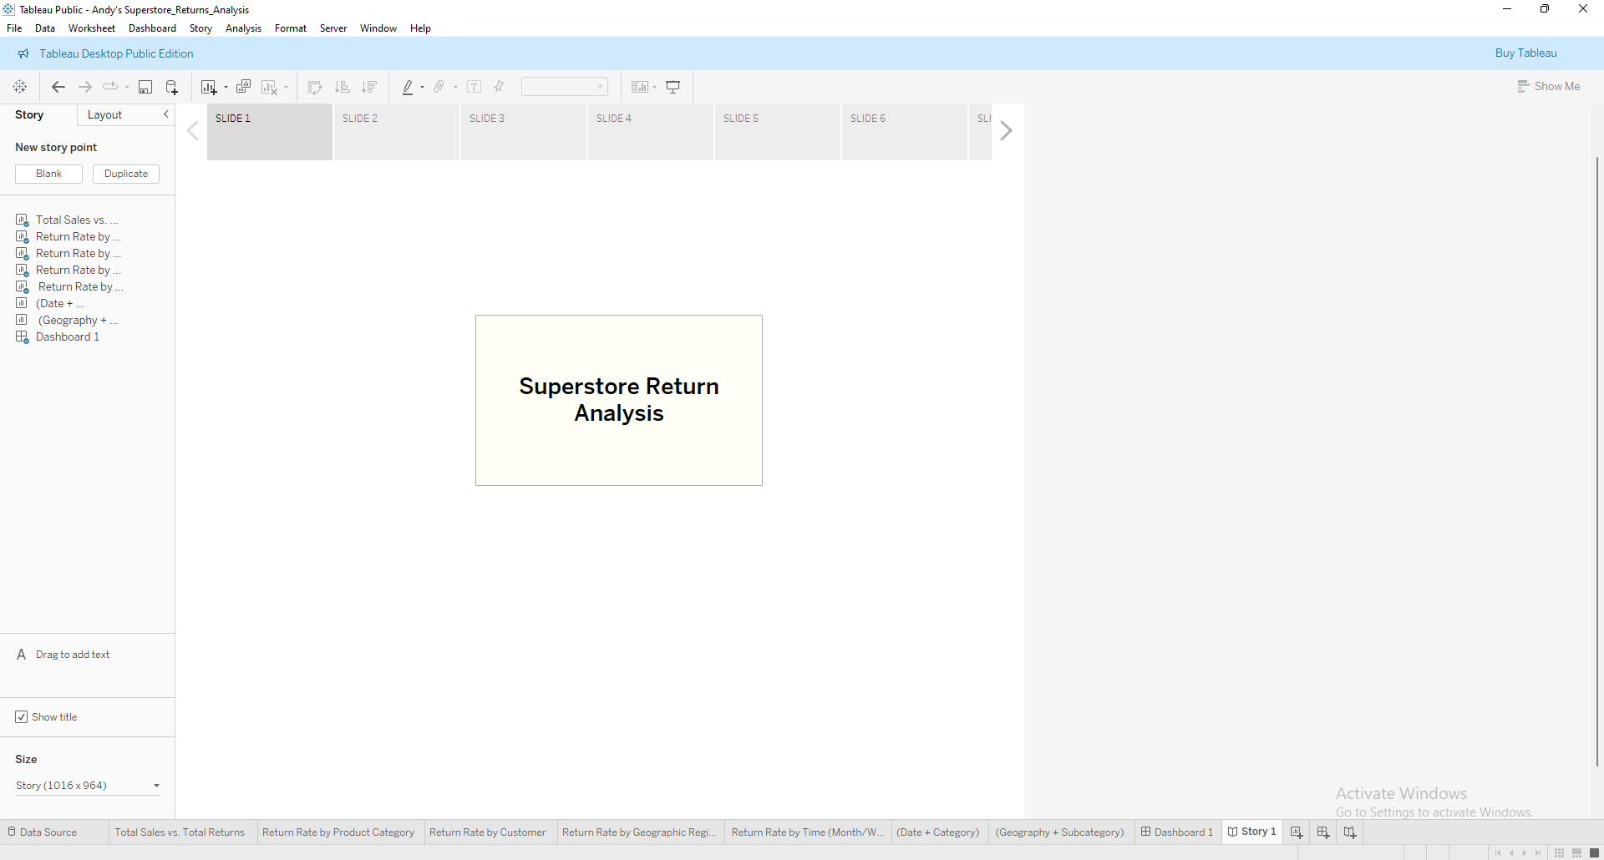
Analysis Slide 1

Slide 9
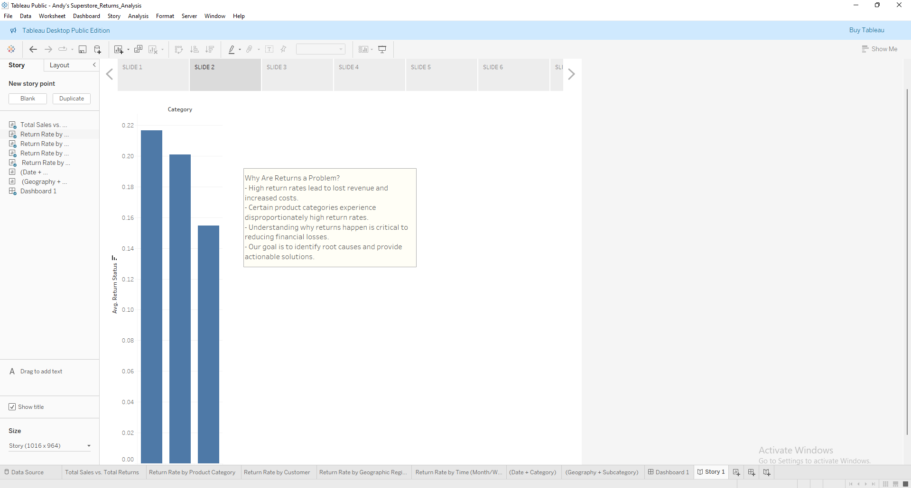
Analysis Slide 2

Slide 10
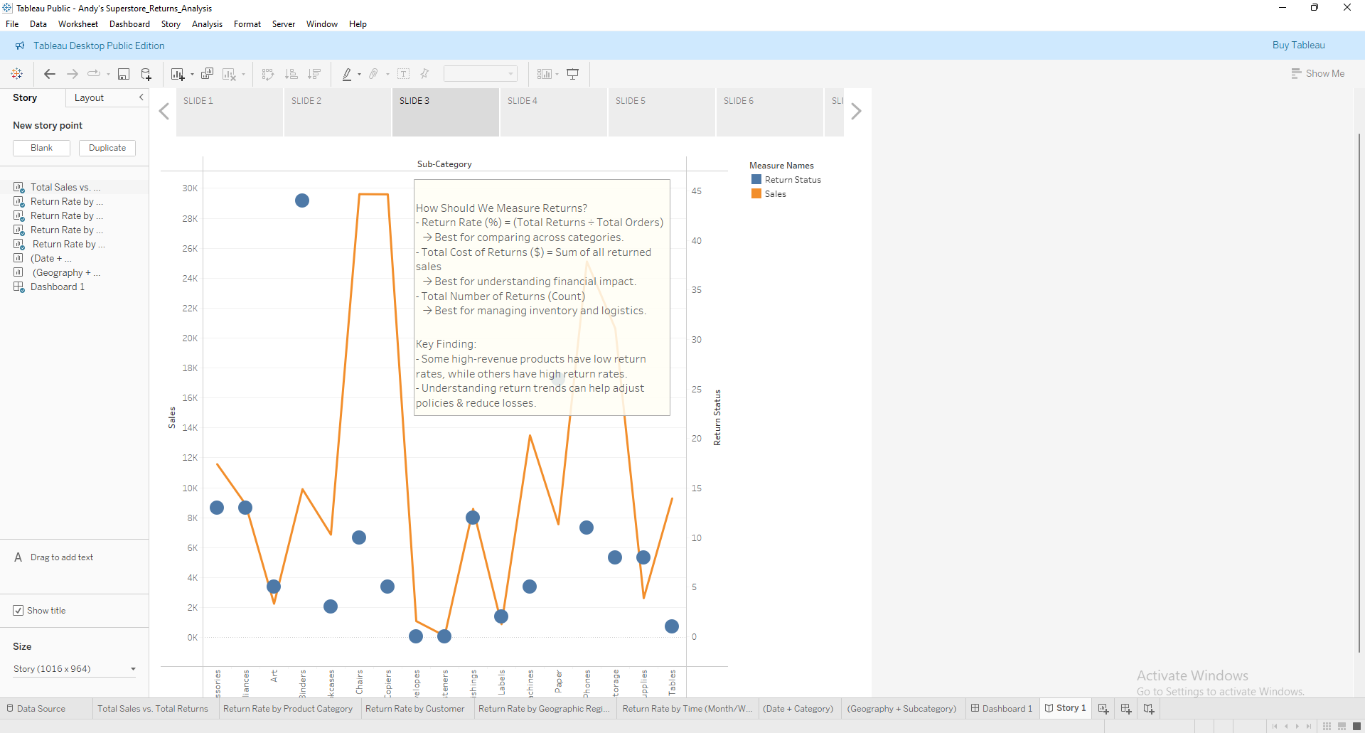
Analysis Slide 3

Slide 11
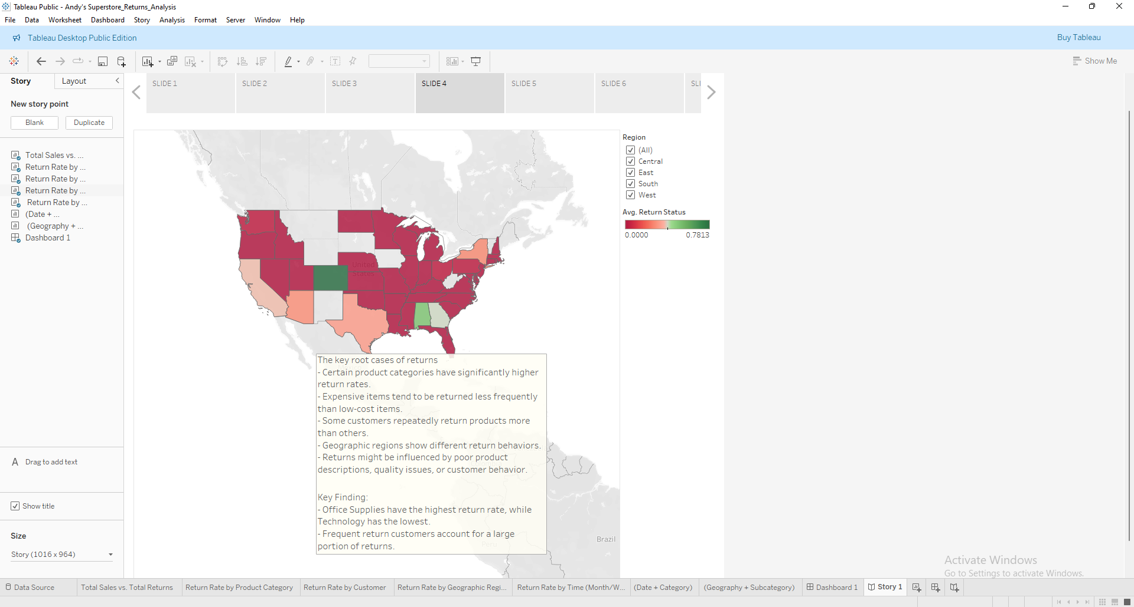
Analysis Slide 4

Slide 12
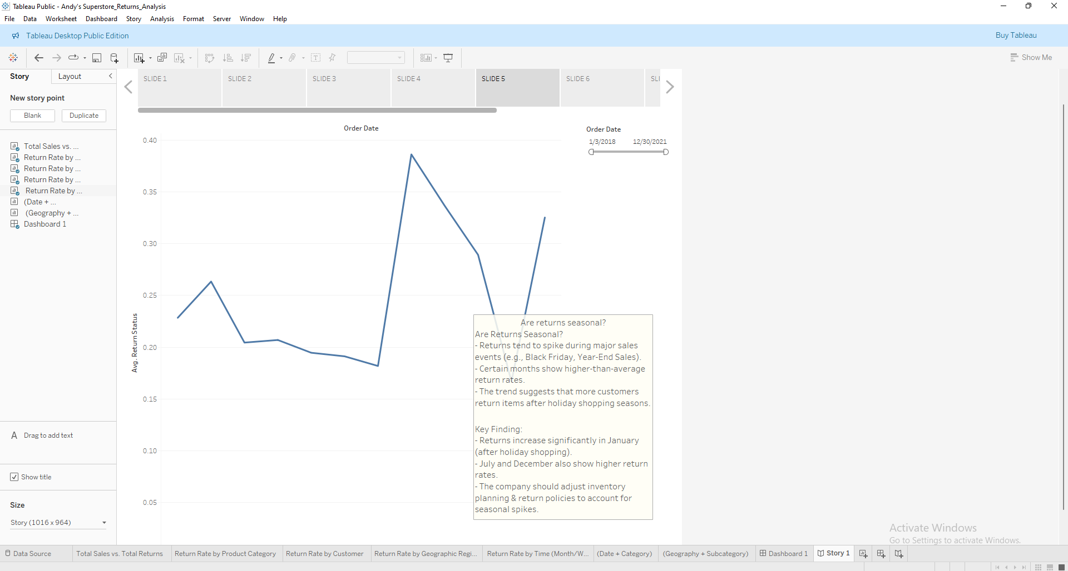
Analysis Slide 5

Slide 13
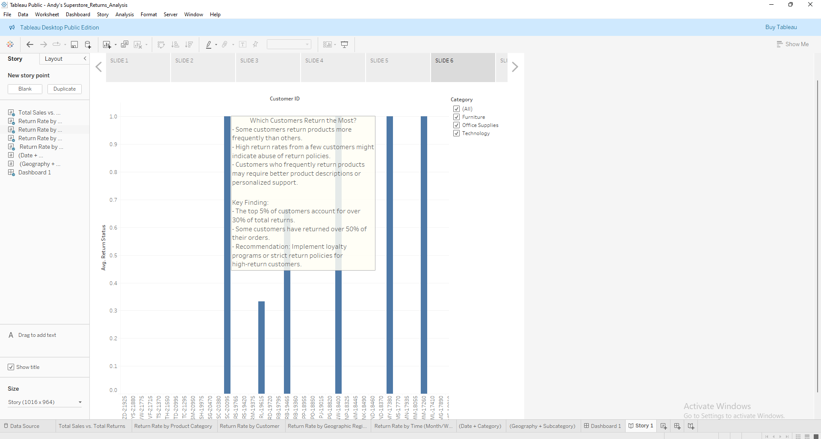
Analysis Slide 6

Slide 14
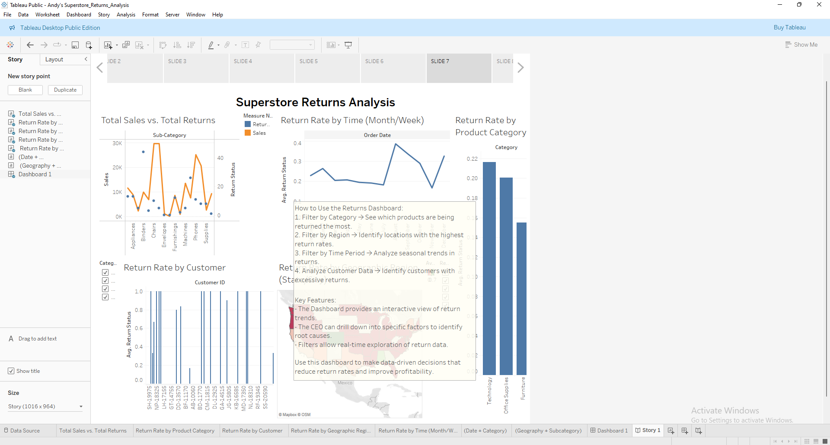
Analysis Slide 7

Slide 15
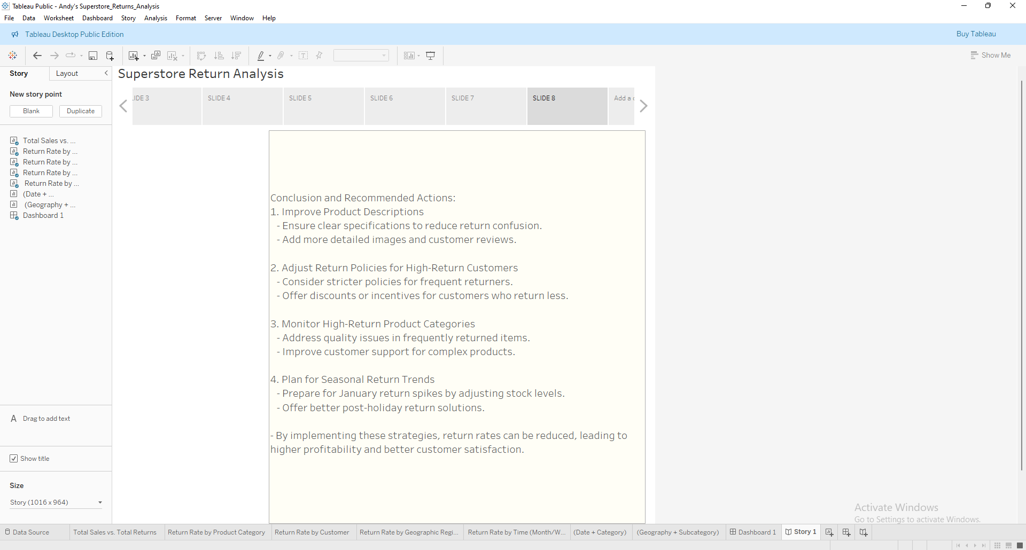
Analysis Slide 8

